Slide 1

Deep Learning Crash Course
Hui Xue
Fall 2021
www.deeplearningcrashcourse.org

Slide 2
Lecture 1
Deep learning as a data driven approach
Running examples
Binary and multi-class classification
Multi-layer perceptron (MLP)

Slide 3
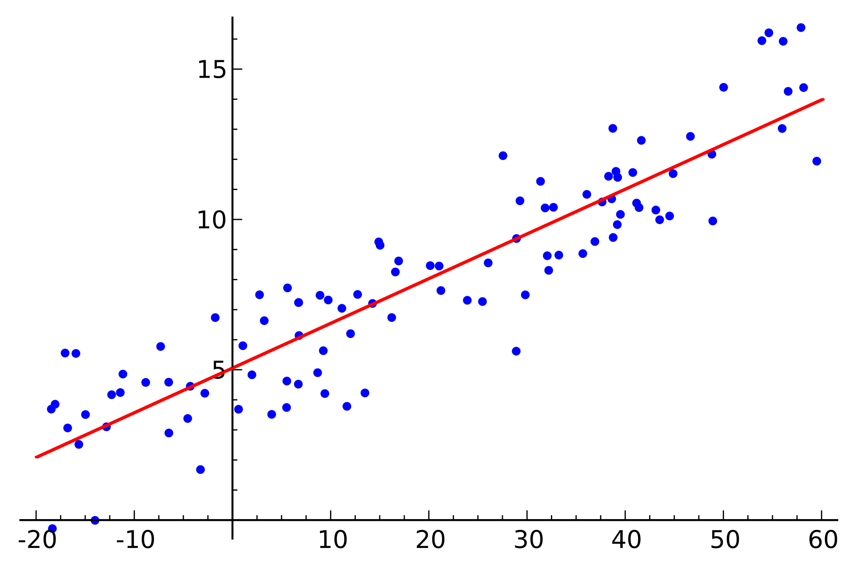
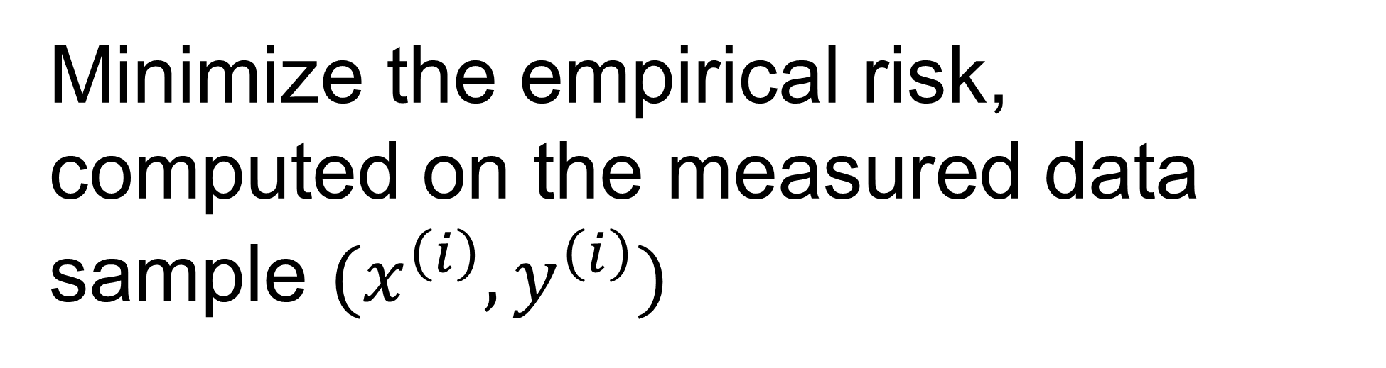
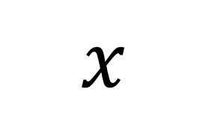
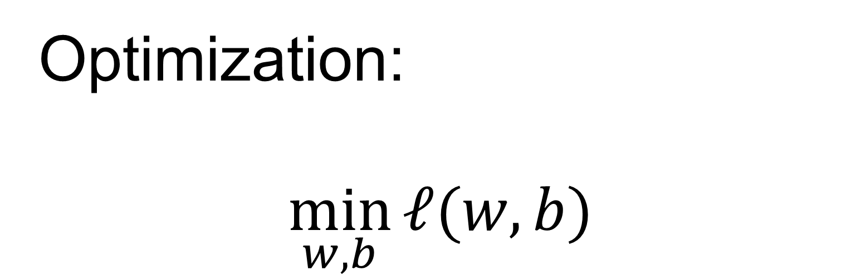
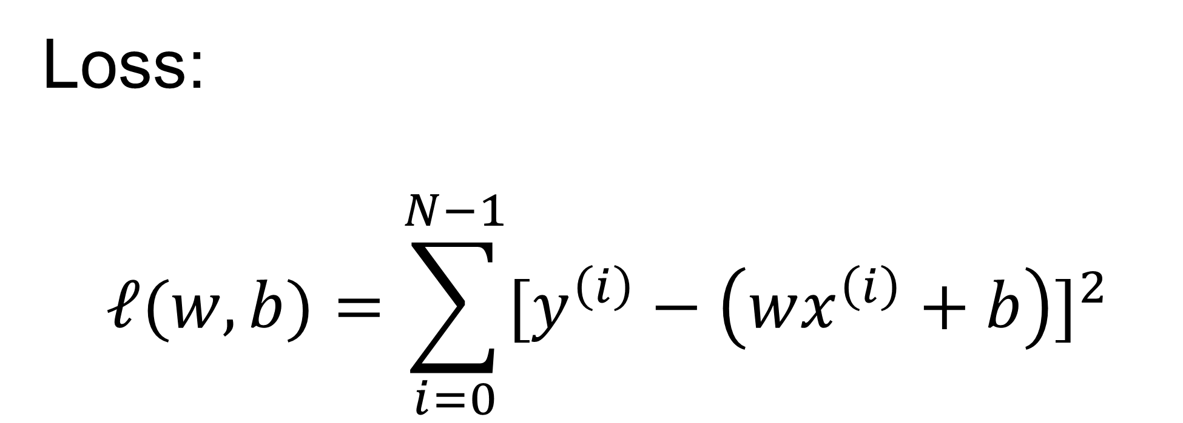
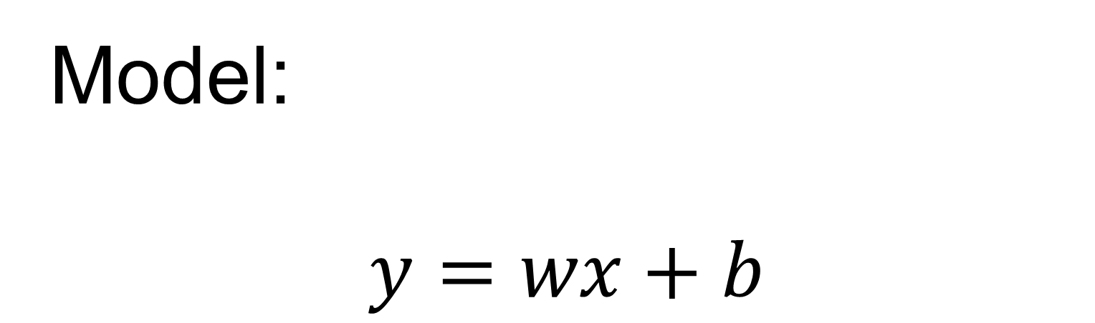
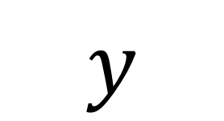
Linear regression
Model:
$$y=wx+b$$
$$y$$
Loss:
$$ℓ(w,b)=\sum_{i=0}^{N−1}{{[y^{\left(i\right)}−\left(wx^{\left(i\right)}+b\right)]}^{2}}$$
Optimization:
$$\min_{w,b}{ℓ(w,b)}$$
$$x$$
Minimize the empirical risk, computed on the measured data sample $(x^{\left(i\right)},y^{\left(i\right)})$
https://en.wikipedia.org/wiki/Linear_regression#/media/File:Linear_regression.svg

Slide 4
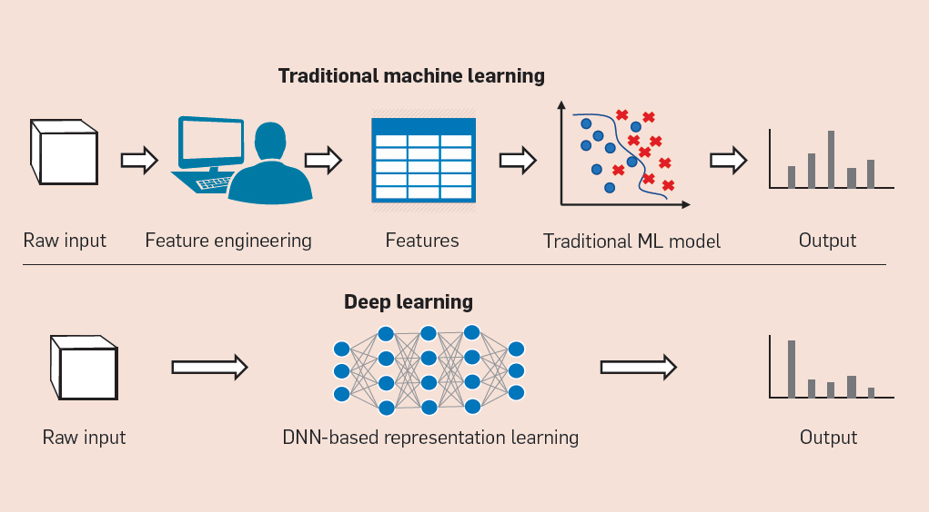
Deep Learning model is data-driven
Learn a good model directly from raw data

Slide 5
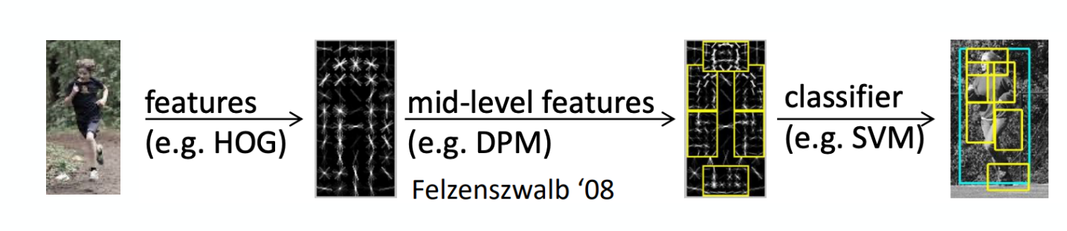
Feature engineering
histogram of oriented gradients
Human design and build feature extractor
Model works on the feature vectors, instead of original data
Limited by the human insights and amount of data
Object Detection with Discriminatively Trained Part Based Models. https://cs.brown.edu/people/pfelzens/papers/lsvm-pami.pdf

Slide 6

Data driven detection
Start from image to object detection (class and bounding box)
End-to-end training, without human crafted features
So powerful, can be done in real-time
https://youtu.be/VOC3huqHrss

Slide 7



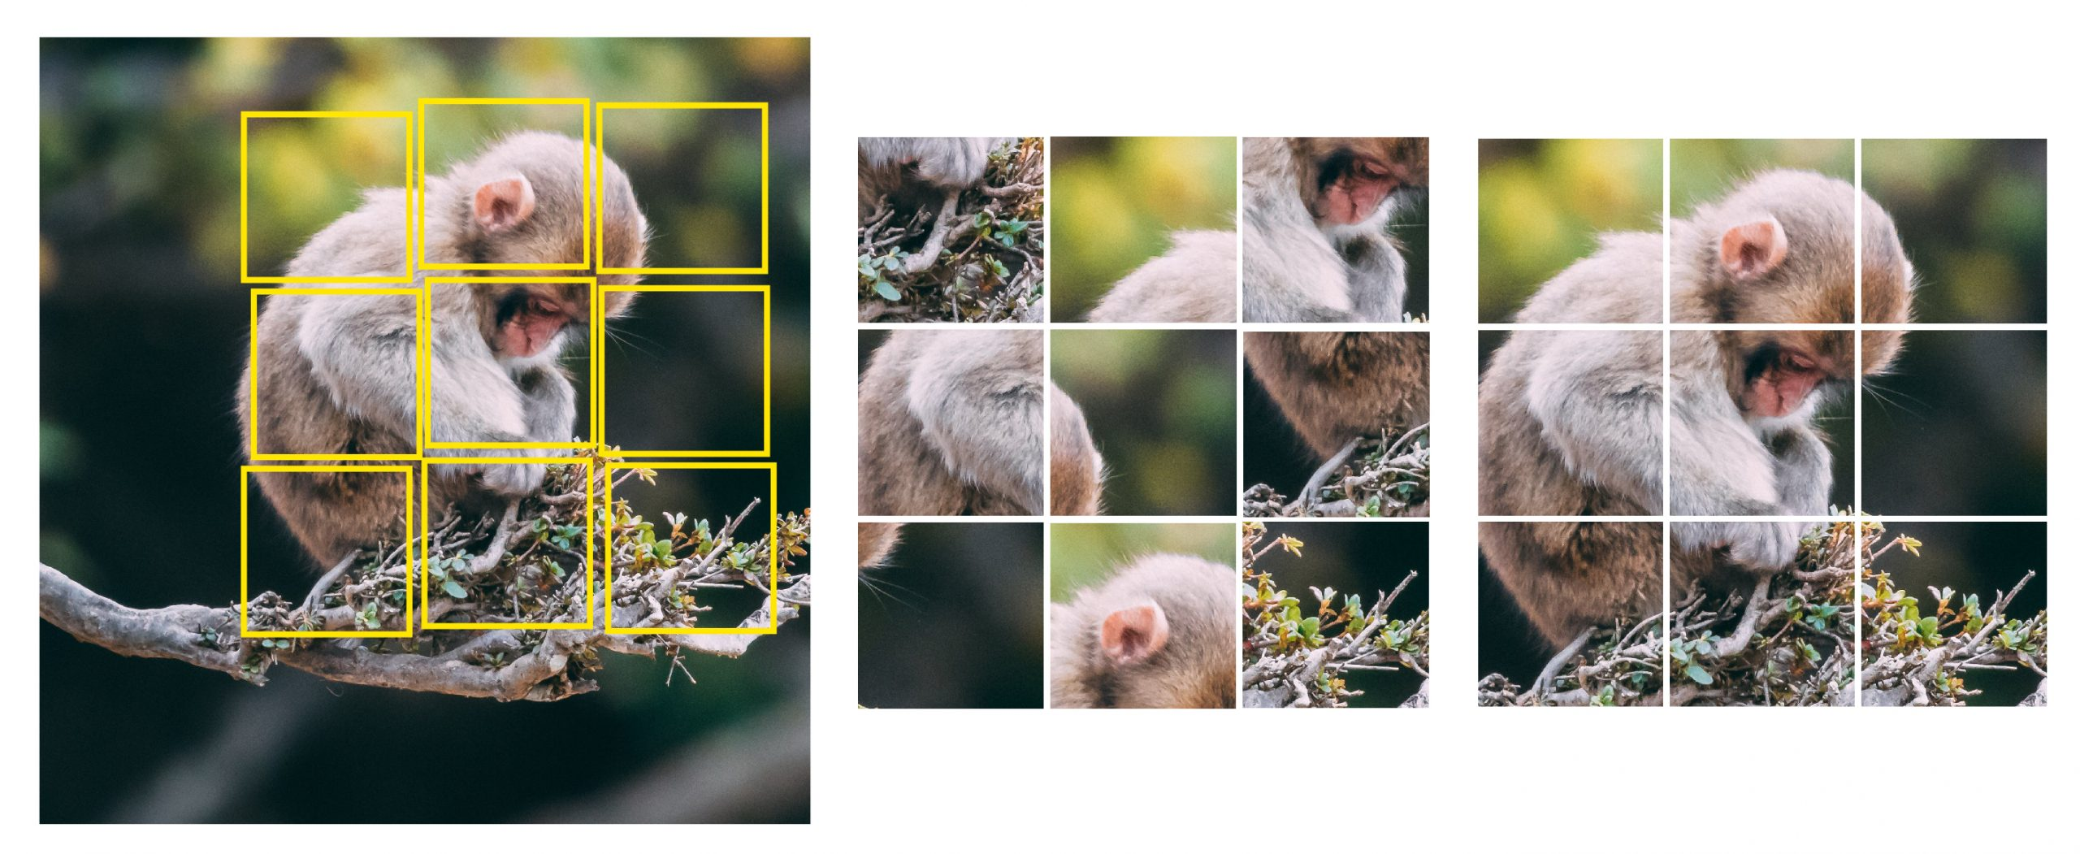
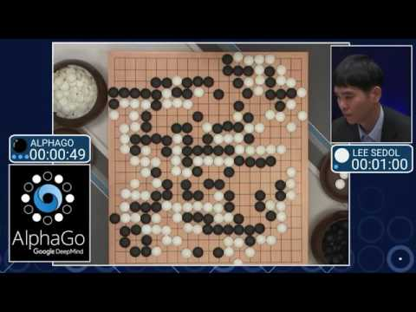
Deep Learning changes the paradigm
Unsupervised Learning
Unlabeled X
Self-supervised Learning
Unlabeled X
Generate self-supervisory signal
Supervised Learning
Learn actions to reach the goal given an environment
Reinforcement Learning
Learn representation in data
Learn effective representation of data to help downstream apps
Labelled X and Y
Learn model: X->Y
Make prediction
Is a cat?
1

Slide 8
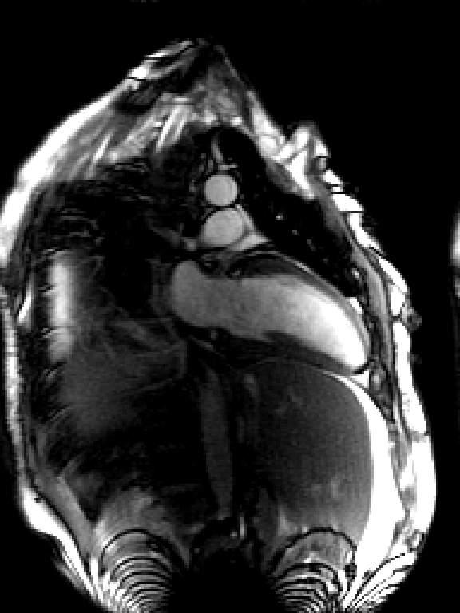
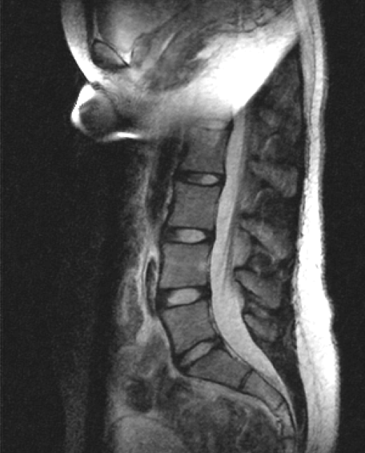
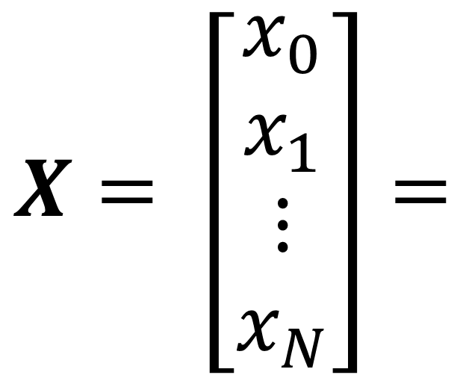
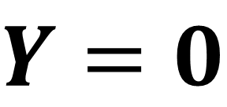
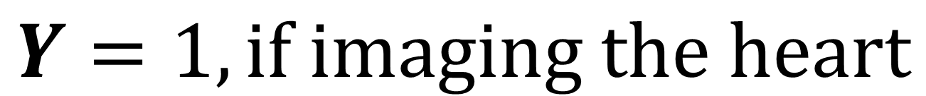
Heart finding problem
A running example : heart finding from MRI images
$$Y=1, if imaging the heart$$
$$X= \left[\begin{matrix}x_{0} \\ x_{1} \\ \begin{matrix}⋮ \\ x_{N}\end{matrix}\end{matrix}\right]=$$
$Y=$ $0$

Slide 9
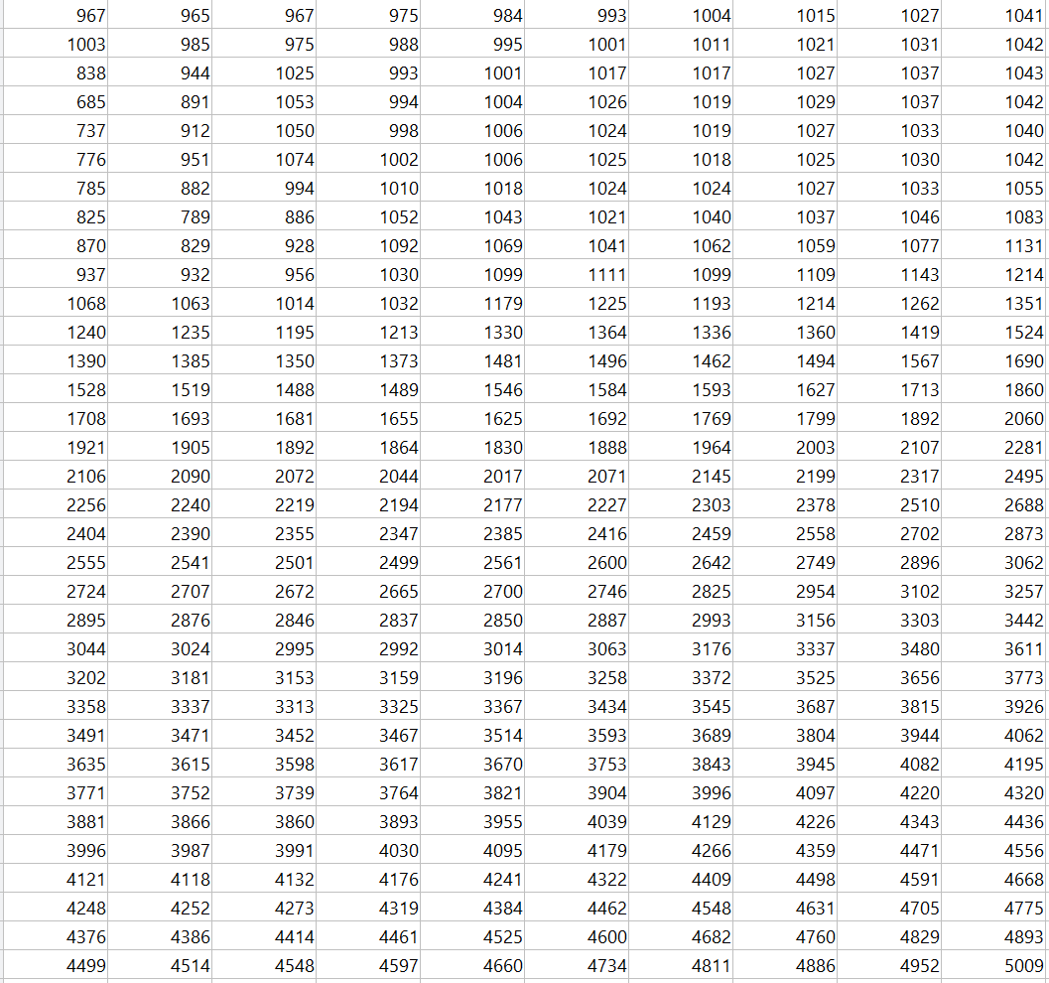
Computer sees the number, not content
What computer sees in this image:

Slide 10
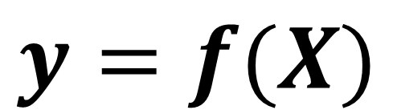
Model as a mapping function
First idea : design a mapping function to map image pixel values to the probability
$$y=f(X)$$
A scalar for the probability where heart was imaged
y : a single floating value
lower case, regular
X : Nx1 vector
N=HxW, number of pixels
upper case, bold

Slide 11
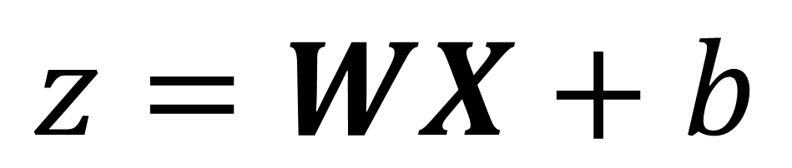
Linear mapping, weights and bias
Start with a linear mapping
$$z=WX+b$$
z : 1x1 scalar
W : 1xN weights matrix
b : 1x1 bias

Slide 12
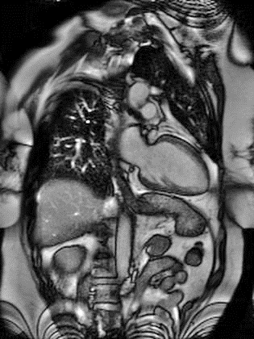
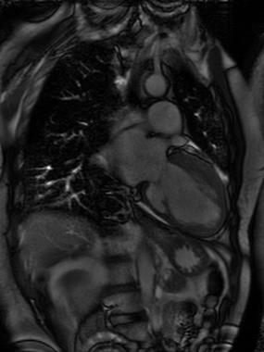
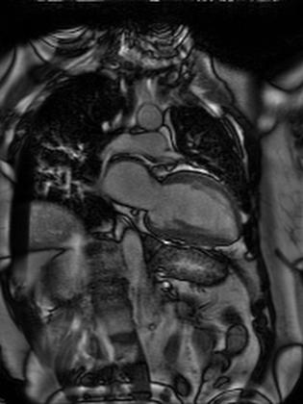
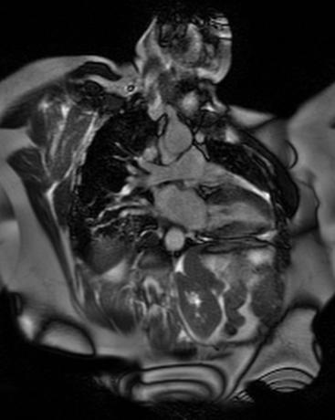
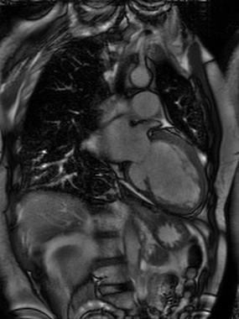
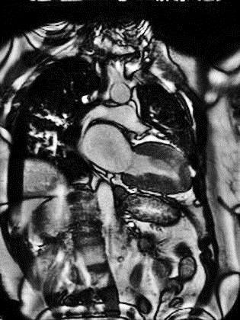
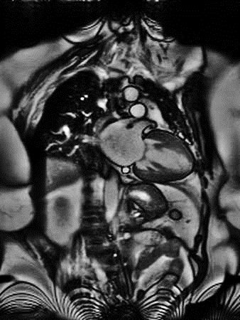
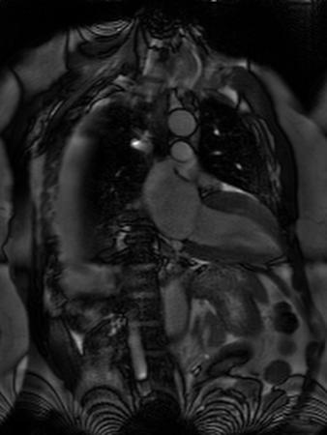
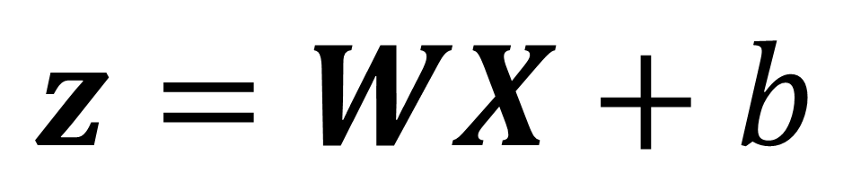
Process a Batch
We can process multiple images in one pass
W and b are the same to all images
B=8, a batch
X : NxB
$$z=WX+b$$
Z : 1xB scalar
score
W : 1xN weights matrix
b : 1x1 bias

Slide 13

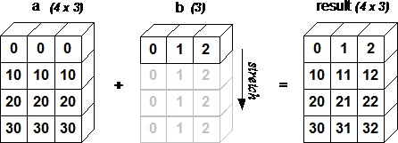
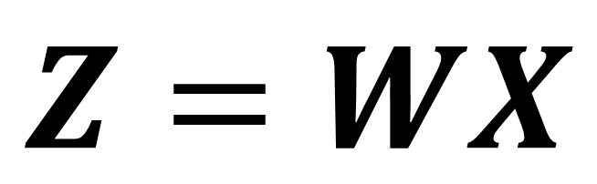
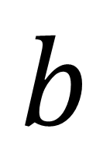

Broadcasting
Question
This sign means you should:
$$Z=WX$$
$$+$$
$$b$$
Add same b to every element of Z
Broadcasting : repeat the smaller array to make its shape compatible to larger array
starts with the trailing (i.e. rightmost) dimensions and works its way left
Repeat any dimension of 1
W : 1xN
X : NxB
So Z is 1xB
1x1 scalar
A (4d array): 8 x 1 x 6 x 1
B (3d array): 7 x 1 x 5
Result (4d array): 8 x 7 x 6 x 5
https://numpy.org/doc/stable/user/basics.broadcasting.html

Slide 14

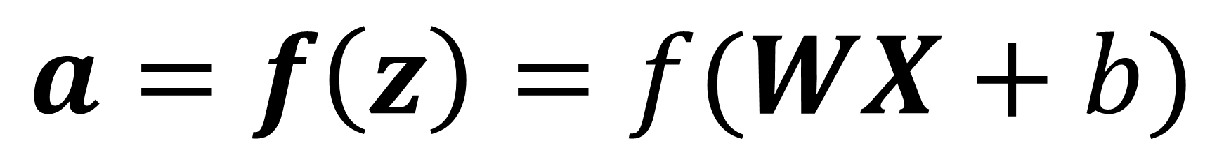
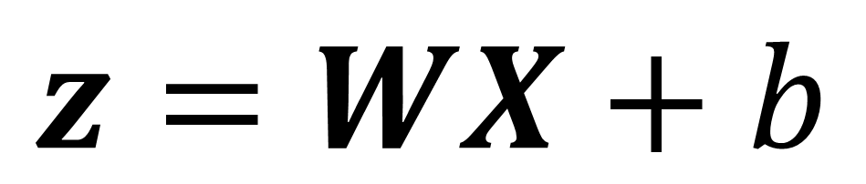
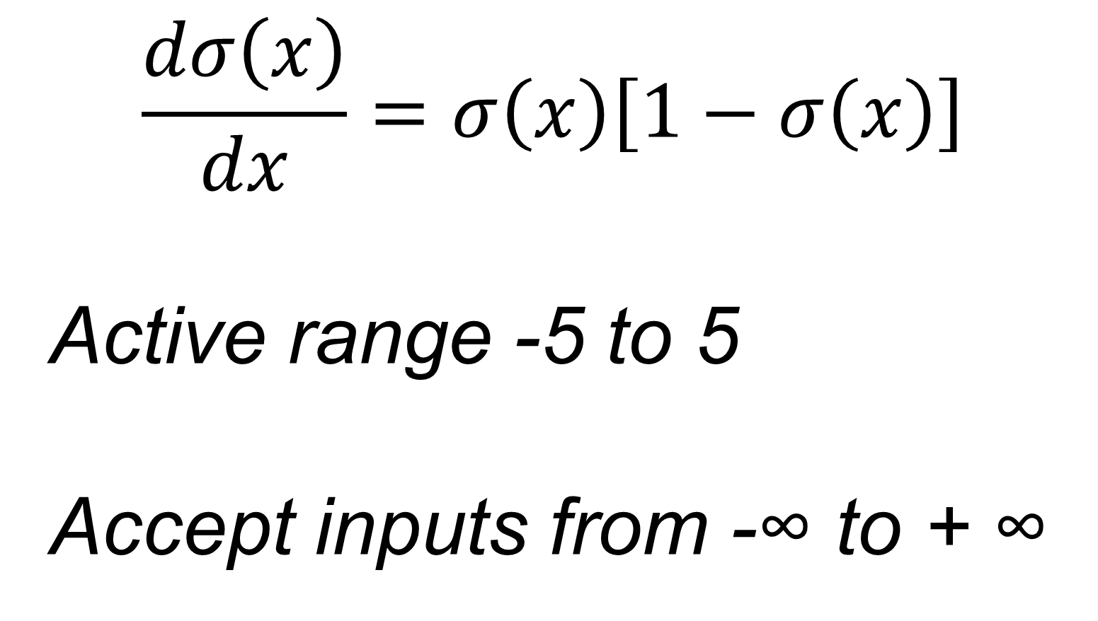
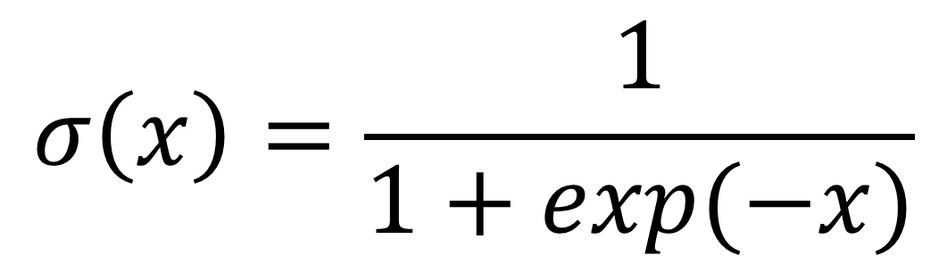
Enforce probability
$$z=WX+b$$
$$a=f\left(z\right)=f(WX+b)$$
f is applied element-wise
A choice of f is the sigmoid function
z is not a value [0 1], so it is not a probability
$$σ\left(x\right)=\frac{1}{1+exp⁡(−x)}$$
Sigmoid function
$$\frac{dσ\left(x\right)}{dx}=σ\left(x\right)\left[1−σ\left(x\right)\right]$$
Active range -5 to 5
Accept inputs from -∞ to + ∞
>5, close to 1
<-5, close to 0

Slide 15

This is a “neuron” in neural network
Neuron = linear mapping + nonlinear activation
Historically, inspired by biological neuron
Not needed to understand today’s deep learning
Building block of DL
Logistic regression if sigmoid nonlinear activation is used
Picture is from https://cs231n.github.io/neural-networks-1/

Slide 16
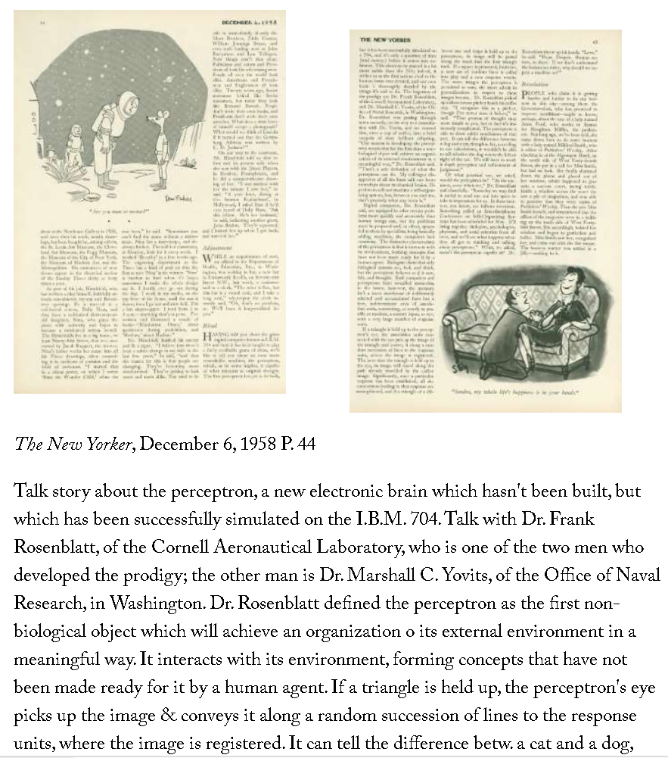
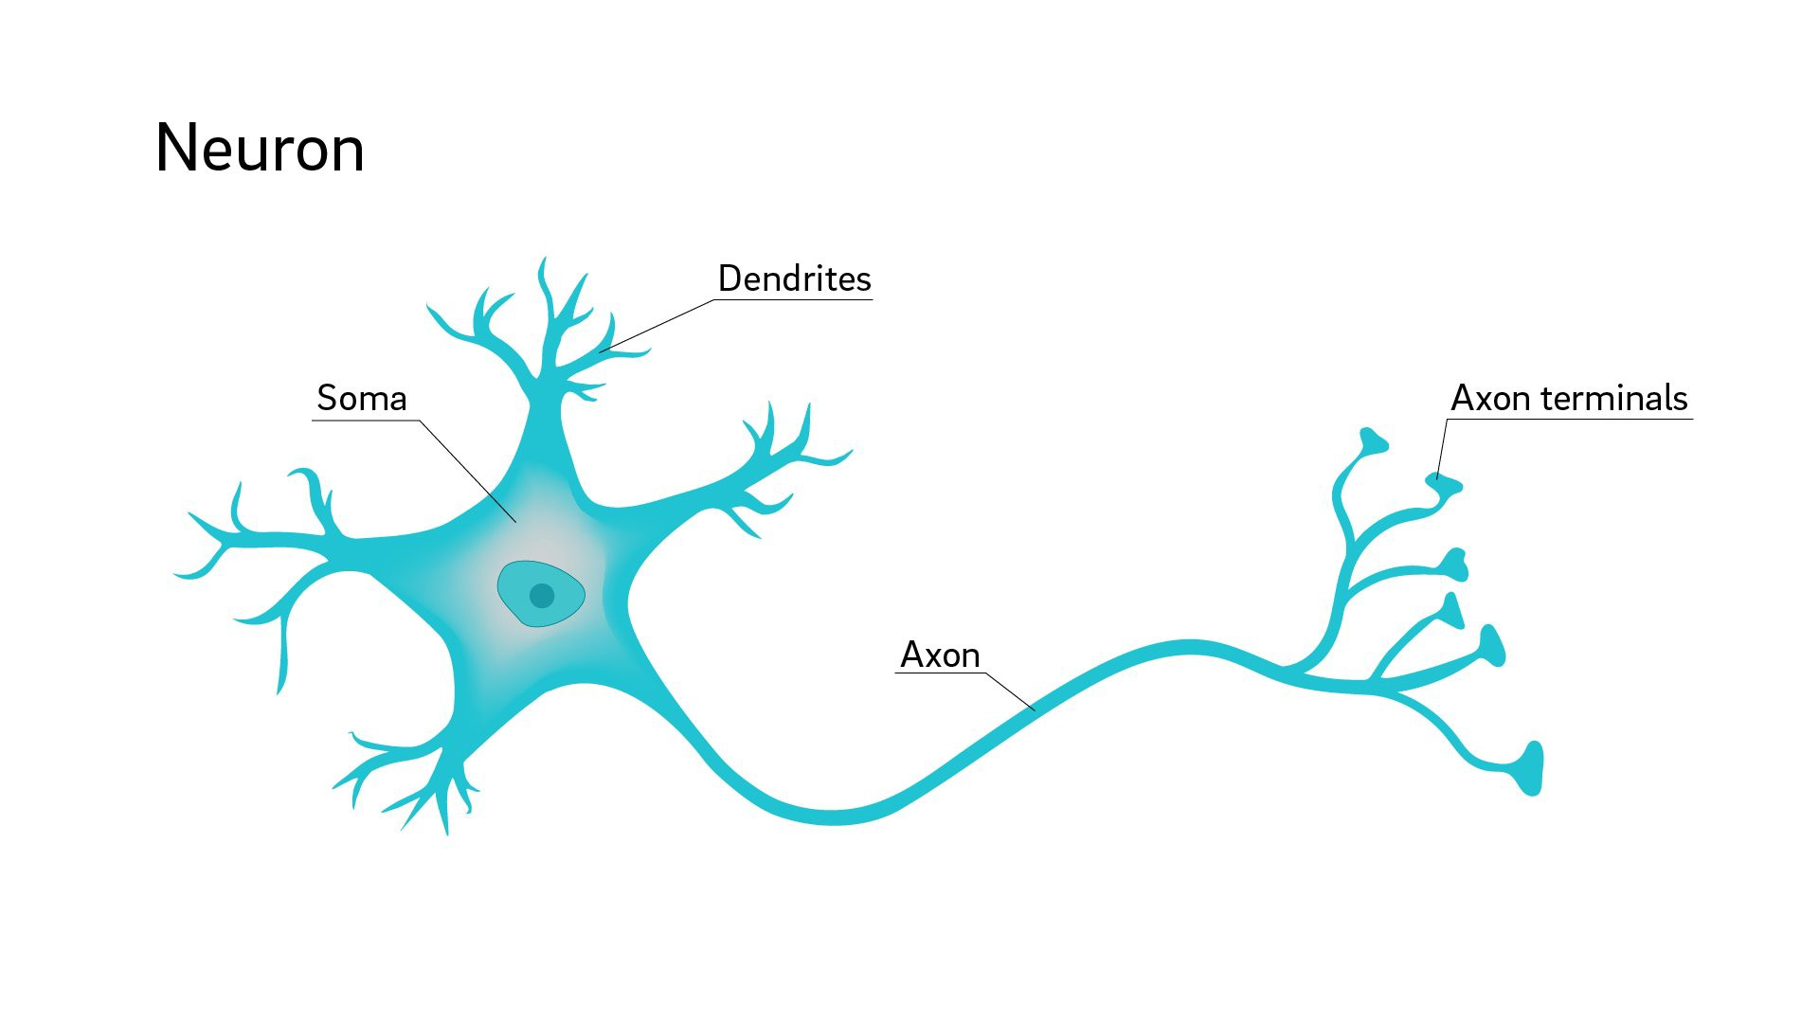
This concept was invented in 1958
https://www.newyorker.com/magazine/1958/12/06/rival-2
https://medium.datadriveninvestor.com/introduction-to-neural-networks-a0fe9ec0a947

Slide 17
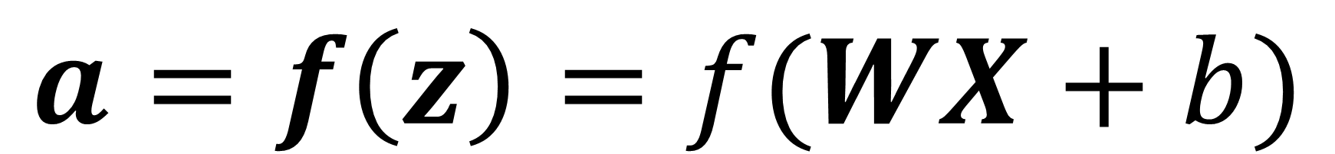


Binary classification
$$a=f\left(z\right)=f(WX+b)$$
>0.5, heart
f
$$a$$
$$X$$
W, b
<0.5, no heart
Only two output status “Yes” or “No”
One scalar is needed
Binary decision

Slide 18
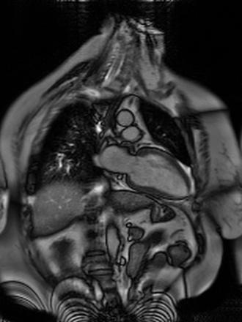
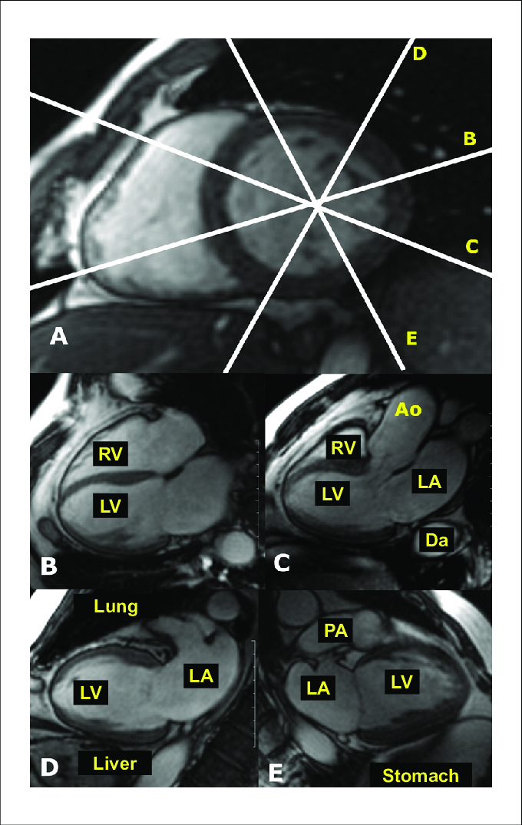
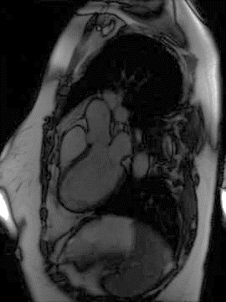
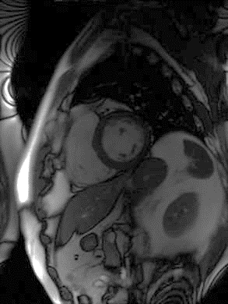
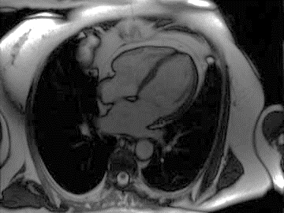
Multi-class classification
Cardiac view detection
E
2 chamber view – CH2
D
3 chamber view – CH3
A
Short-axis view SAX
B
4 chamber view – CH4
https://www.scielo.br/scielo.php?script=sci_arttext&pid=S0066-782X2010001600014&lng=pt&nrm=iso&tlng=pt

Slide 19
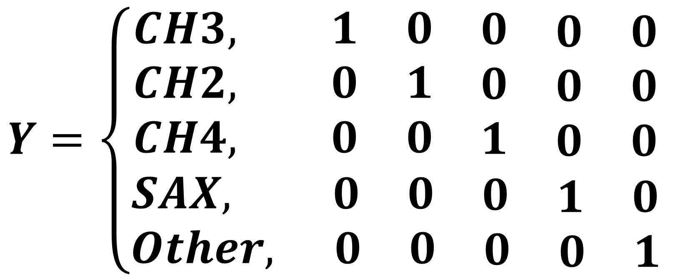
Multi-class classification
Cardiac view detection
E
2 chamber view – CH2
D
3 chamber view – CH3
Given an image, decide which imaging view it is
$$Y=\left\{\begin{aligned}\begin{matrix}CH3, 1 & 0 & \begin{matrix}0 & \begin{matrix}0 & 0\end{matrix}\end{matrix} \end{matrix} \\ \begin{matrix}CH2, 0 & 1 & \begin{matrix}0 & \begin{matrix}0 & 0\end{matrix}\end{matrix} \end{matrix} \\ \begin{matrix}CH4, 0 & 0 & \begin{matrix}1 & \begin{matrix}0 & 0\end{matrix}\end{matrix} \end{matrix} \\ SAX, \begin{matrix} 0 & 0 & \begin{matrix}0 & \begin{matrix}1 & 0\end{matrix}\end{matrix} \end{matrix} \\ Other, \begin{matrix} 0 & 0 & \begin{matrix}0 & \begin{matrix}0 & 1\end{matrix}\end{matrix} \end{matrix}\end{aligned}\right.$$
A
Short-axis view SAX
Now we need 5 numbers for K=5 classes
This type of encoding y is “one-hot encoding”
B
4 chamber view – CH4

Slide 20
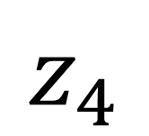

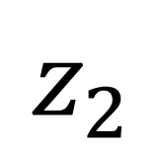
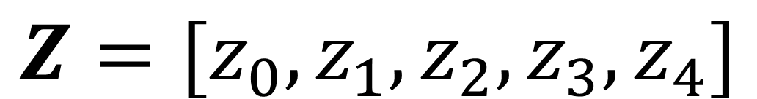
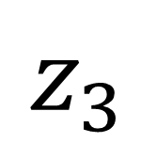
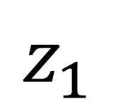
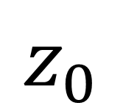
Multi-class classification
W0, b0
$$z_{0}$$
Generate 5 numbers as the score for each class
W1, b1
$$z_{1}$$
$$Z=[z_{0},z_{1},z_{2},z_{3},z_{4}]$$
$$X$$
W2, b2
$$z_{2}$$
X : NxB, images
W0, W1, …, W4: 1XN weights
b0, b1, …, b4: 1x1 bias
W3, b3
$$z_{3}$$
W4, b4
$$z_{4}$$

Slide 21


Multi-class classification
X : NxB, images
W0, W1, …, W4: 1XN weights
b0, b1, …, b4: 1x1 bias
We can put all weights in one matrix and bias
W0, b0
$$z_{0}$$
W1, b1
$$z_{1}$$
$$X$$
$$W=\left[\begin{matrix}\begin{matrix}− & W0 & −\end{matrix} \\ \begin{matrix}− & W1 & −\end{matrix} \\ \begin{matrix}\begin{matrix}− & W2 & −\end{matrix} \\ \begin{aligned}\begin{matrix}− & W3 & −\end{matrix} \\ \begin{matrix}− & W4 & −\end{matrix}\end{aligned}\end{matrix}\end{matrix}\right]$$
W2, b2
$$z_{2}$$
KxN matrix, every row for each class
W3, b3
$$z_{3}$$
$$b=\left[\begin{aligned}b0 \\ b1 \\ b2 \\ b3 \\ b4\end{aligned}\right]$$
Kx1 vector
W4, b4
$$z_{4}$$

Slide 22

Multi-class classification
W0, b0
$$z_{0}$$
Matrix representation:
W1, b1
$$z_{1}$$
$$z= WX+b$$
$$X$$
W2, b2
$$z_{2}$$
X: NxB, input images
W: KxN, weights
b: Kx1, bias
Z: KxB, score
W3, b3
$$z_{3}$$
W4, b4
$$z_{4}$$

Slide 23



Softmax
softmax
W0, b0
$$z_{0}$$
$$softmax\left(Z\right)=\frac{exp⁡(z_{i})}{\sum_{j=0}^{K}{{exp⁡(z}_{j})}}$$
W1, b1
$$z_{1}$$
$$X$$
W2, b2
$$z_{2}$$
$$a$$
Softmax trick:
W3, b3
$$z_{3}$$
$$softmax\left(Z−c\right)=softmax(Z)$$
$$compute softmax\left(Z\right) as softmax\left(Z−max(Z) \right)$$
W4, b4
$$z_{4}$$
Better numeric stability

Slide 24

Logits
softmax
W0, b0
$$z_{0}$$
When score Z is used as inputs to softmax, it is also called “logits”
W1, b1
$$z_{1}$$
In the machine learning, logits can be defined as a vector of raw predictions that are inputted into normalization function to generate probabilities.
$$X$$
W2, b2
$$z_{2}$$
$$a$$
$$logits\left(a\right)=log⁡(\frac{a}{1−a})$$
$$a ∈\left[0, 1\right], logits∈(−∞, +∞)$$
W3, b3
$$z_{3}$$
W4, b4
$$z_{4}$$

Slide 25







Logits
logits
The term “logits” is often used in DL frameworks
Same concept for binary classification
When models are illustrated, often the sigmoid/softmax are included in the model plotting
Loss is computed on $L(y,\hat{y})$; every sample is $(x,y)$; model outputs $\hat{y}$
Model
sigmoid
$$X$$
$$z$$
$$\hat{y}$$
Model
softmax
$$X$$
$$z$$
$$\hat{y}$$

Slide 26





Universal Approximation
Question
This sign means you should:
W₁^{[1]}
f
$$X$$
W₂^{[1]}
f
W₁^{[2]}
f
… …
… …
W_{N}^{[1]}
f
Can a MLP approximate any functions?
https://www.sfu.ca/~ssurjano

Slide 27


Universal Approximation
Question
This sign means you should:
Can a MLP approximate any functions?
W₁^{[1]}
f
$$X$$
W₂^{[1]}
f
W₁^{[2]}
… …
… …
https://doi.org/10.1016/0893-6080(91)90009-T
W_{N}^{[1]}
f
In short: A MLP with at least one hidden layer and nonlinear activation function can approximate any continuous function.
https://en.wikipedia.org/wiki/Universal_approximation_theorem

Slide 28


Binary vs. multi-class classification
Binary
Multi-class
$$a=σ(WX+b)$$
$$a=softmax(WX+b)$$
X : NxB
W : 1xN
b : 1x1
a : 1xB
Apply sigmoid element-wise
X : NxB
W : KxN
b : Kx1
a : KxB
Apply softmax along class K
We used one layer of linear mapping and one nonlinear activation function

Slide 29

Activation functions
Question
This sign means you should:

Slide 30


Multi-layer Perceptron (MLP)
W₁^{[1]}
f
W₁^{[2]}
f
Index of layer
flatten
f
f
W₁^{[2]}
$$X$$
W₂^{[1]}
W₁^{[3]}
$$a^{[3]}$$
W₂^{[2]}
f
Index of neuron
W₃^{[1]}
f

Slide 31

Multi-layer Perceptron (MLP)
W₁^{[1]}
f
W₁^{[2]}
f
Index of layer
flatten
f
f
W₁^{[2]}
$$X$$
W₂^{[1]}
W₁^{[3]}
$$a^{[3]}$$
W₂^{[2]}
f
Index of neuron
W₃^{[1]}
f
Layer 3 / output layer
This is a two-layer network (does not count input layer).
Input Layer 1
Hidden Layer 2

Slide 32



Multi-layer Perceptron (MLP)
W₁^{[1]}
f
X : N x1
W^{[1]} : 3xN
b^{[1]} : 3x1
Z^{[1]} : 3x1
a^{[1]} : 3x1
f : applied element-wise
$$X$$
W₂^{[1]}
f
$$Z^{[1]}=W^{\left[1\right]}X+b^{[1]}$$
$$a^{[1]}=f(Z^{\left[1\right]})$$
W₃^{[1]}
f

Slide 33



Multi-layer Perceptron (MLP)
a^{[1]} : 3x1
W^{[2]} : 2x3
b^{[2]} : 2x1
Z^{[2]} : 2x1
a^{[2]} : 2x1
f : applied element-wise
W₁^{[2]}
f
$$a^{[1]}$$
$$Z^{[2]}=W^{\left[2\right]}X+b^{[2]}$$
$$a^{[2]}=f(Z^{\left[2\right]})$$
W₂^{[2]}
f

Slide 34



Multi-layer Perceptron (MLP)
a^{[2]} : 2x1
W^{[3]} : 1x2
b^{[3]} : 1x1
Z^{[3]} : 1x1
a^{[3]} : 1x1
f : applied element-wise
W₁^{[3]}
f
$$Z^{[3]}=W^{[3]}a^{[2]}+b^{[3]}$$
$$a^{[2]}$$
$$a^{[3]}=f(Z^{\left[3\right]})$$

Slide 35







Forward Pass
$$Z^{[1]}=W^{\left[1\right]}X+b^{[1]}$$
$$a^{[1]}=f(Z^{\left[1\right]})$$
Forward pass: from input X to output $\hat{y}$
For every layer,
W.shape is [number of output, number of input]
b.shape is [number of input, 1]
$$Z^{[2]}=W^{\left[2\right]}X+b^{[2]}$$
$$a^{[2]}=f(Z^{\left[2\right]})$$
$$Z^{[3]}=W^{[3]}a^{[2]}+b^{[3]}$$
$${\hat{y}=a}^{[3]}=f(Z^{\left[3\right]})$$

Slide 36








Number of parameters?
W₁^{[1]}
f
$$Z^{[1]}=W^{\left[1\right]}X+b^{[1]}$$
3N+3
W₁^{[2]}
f
$$a^{[1]}=f(Z^{\left[1\right]})$$
0
$$X$$
W₂^{[1]}
f
W₁^{[3]}
f
$$a^{[3]}$$
$$Z^{[2]}=W^{\left[2\right]}X+b^{[2]}$$
2x3+2=8
$$a^{[2]}=f(Z^{\left[2\right]})$$
0
W₂^{[2]}
f
$$Z^{[3]}=W^{[3]}a^{[2]}+b^{[3]}$$
1x2+1=3
f
$${\hat{y}=a}^{[3]}=f(Z^{\left[3\right]})$$
0
W₃^{[1]}
3N+14

Slide 37




Nonlinear activation is necessary
W₁^{[1]}
f
$$Z^{[1]}=W^{\left[1\right]}X+b^{[1]}$$
W₁^{[2]}
f
$$a^{[1]}=Z^{\left[1\right]}$$
$$X$$
W₂^{[1]}
f
W₁^{[3]}
f
$$a^{[3]}$$
$$Z^{[2]}=W^{\left[2\right]}a^{[1]}+b^{[2]}$$
$$a^{[2]}=Z^{\left[2\right]}$$
W₂^{[2]}
f
$$Z^{[3]}=W^{[3]}a^{[2]}+b^{[3]}$$
W₃^{[1]}
f
$${\hat{y}=a}^{[3]}=Z^{\left[3\right]}=W^{[3]}a^{[2]}+b^{[3]}$$
$$={W^{[3]}(W}^{\left[2\right]}a^{[1]}+b^{[2]})+b^{[3]}$$
$$={W^{\left[3\right]}(W}^{\left[2\right]}(W^{\left[1\right]}X+b^{\left[1\right]})+b^{\left[2\right]})+b^{\left[3\right]}$$
$=$ ${W^{\left[3\right]}W}^{\left[2\right]}W^{\left[1\right]}X$+ ${W^{\left[3\right]}W}^{\left[2\right]}b^{[1]}+W^{\left[3\right]}b^{\left[2\right]}+b^{\left[3\right]}$
A linear model …

